Slide 1
Logistic Regression

Slide 2
Introduction
Logistic regression similar to linear regression and can handle categorical values for features
Commonly used for classification, as it can output a value that corresponds to the probability of belonging to a given class
Usually used to estimate the probability that an instance belongs to a particular class (e.g., what is the probability that this email is spam?)
If the estimated probability is greater than 50%, then the model predicts that the instance belongs to that class or else it predicts that it does not - binary classifier

Slide 3
Applications of logistic regression
Binary classification
Example email spam or ham
Multinomial classification
Multiple output classes - predict if image is cat or dog or fish
Ordinal classification - with ordering
Rating of restaurants

Slide 4
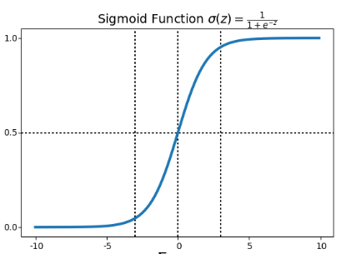
Logistic Regression
Like a Linear Regression model, a Logistic Regression model computes a weighted sum of the input features (plus a bias term), it outputs the logistic of this result
Logistic regression model outputs can be interpreted as probabilities of the occurrence of a target level
transforms any value in the domain (−∞,∞) to a number between 0 and 1
When z is a small negative number, output close to 0, z is a small positive number, output close to 1, when z=0, output is .5

Slide 5
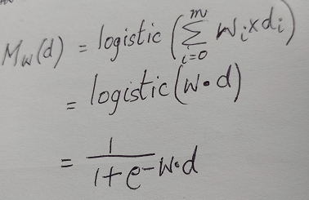
Logistic Regression
Thus, to build a logistic regression model, we threshold the output of the basic linear regression model using the signmoid function or logistic function
The dot product of weights and descriptive feature values is passed through the logistic function
How does a Logistic Regression model estimate probabilities and makes predictions?
If the two classes in the binary classification are designated 0 and 1, output is 0 if probability < 0.5 and 1 if probability >.5

Slide 6

Training a logistic regression model
Let p denote M_{w}(d) and Θ denote the weight vector
The objective is to set the weights such that the probabilities are high for positive instances and low for negative instances
Recall that probability is just the linear regression model put through the sigmoid function
The following cost function satisfies this property
c(Θ) = - log (p) if output = 1
-log (1-p) if output is 0
The cost function Mean Square Error which we use for Linear Regression cannot be used since it will not be convex and gradient descent will not converge
The cost function over the whole training set is simply the average cost over all training instances. It can be written in a single expression

Slide 7
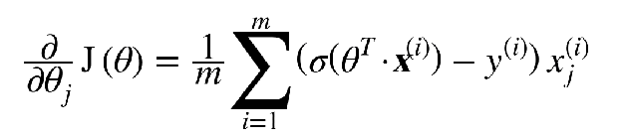
Training a logistic regression model
Cost function is convex, so Gradient Descent will find the global minimum
Recap the notation - x is independent variable, y is target variable, Θ is the weight vector
The partial derivatives of the cost function with regards to the jth model parameter θj is
for each instance it computes the prediction error and multiplies it by the jth feature value, and then it computes the average over all training instance - very similar to linear regression error function

